Slide 1

GOVERNMENT COLLEGE OF ENGINEERING
SALEM-11
TOPIC : WEB SCRAPING : DATA HARVESTING MASTERY
TEAM MEMBERS : GUIDE NAME
LINGESH. G (61772221L02) Dr .P. NITHYA
MOHAN RAJ R (61772221L03)
LEJESH. K (61772221T305)

Slide 2
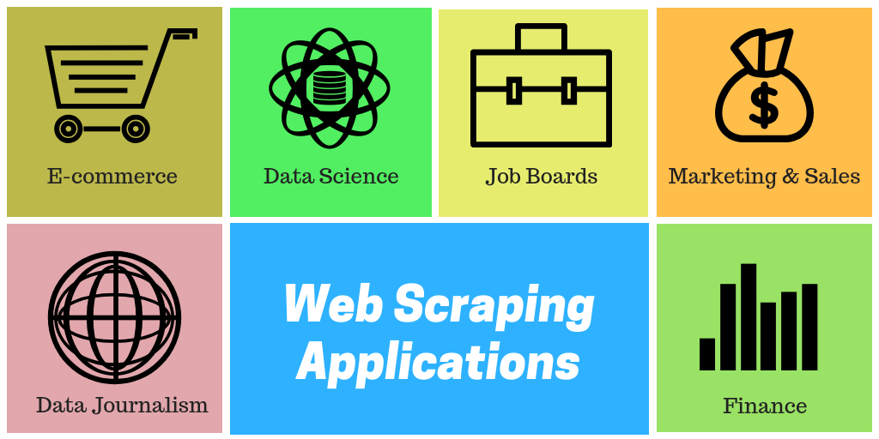
INTRODUCTION
Web scraping (web harvesting or web data extraction) is a computer software technique of extracting information from websites.
Web scraping typically targets one web site at a time to extract unstructured information and put it in a structured form for reuse.
Web Scraping can be used by companies to scrap the product data for their products and competing products as well to see how it impacts their pricing strategies.
Companies can use this data to fix the optimal pricing for their products so that they can obtain maximum revenue.

Slide 3

PROBLEM STATEMENT
Extracting data from websites, offering numerous benefits in various domains such as business intelligence, research, and market analysis.

Slide 4
MOTIVATION
Empowering Decision-Making: By gathering data from various sources, we gain a comprehensive understanding of trends, patterns, and opportunities, enabling informed decision-making.
Efficiency Redefined: Automating the data collection process frees up valuable time and resources, allowing us to focus on analysis and innovation.
Uncovering Hidden Gems: Beneath the surface of the web lies a treasure trove of untapped data waiting to be discovered. Through web scraping, we unearth these hidden gems and unlock their potential.

Slide 5
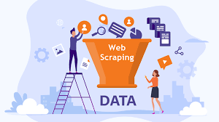
ABSTRACT
Web Scraping is the method of extracting data from websites in an automated way.
Web scraping to obtain large amounts of data from websites. Most of this data is unstructured data in an HTML format which is then converted into structured data in a spread sheet or database so that it can be used in various applications.
High-quality web scraped data obtained in large volumes can be very helpful for companies in analyzing consumer trends and understanding which direction the company should move in the future.

Slide 6
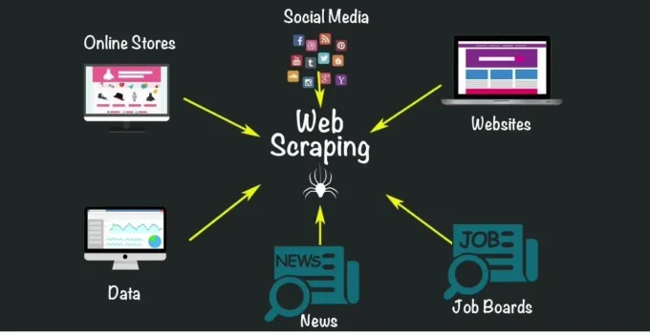
OBJECTIVES
Market Research
Competitor Analysis
Price Monitoring
Academic Purpose
Research

Slide 7
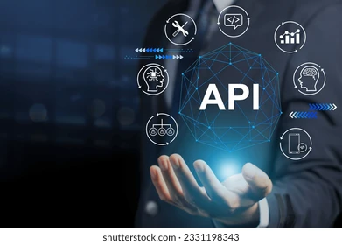

EXISITING SYSTEM
Manual Data Entry.
API(Application Programming Interfaces)
Contacting the Website Owner
Publicly Available Datasets

Slide 8

PROPOSED SYSTEM
customized to meet specific scraping needs and business requirements.
Extracting the large amount of data very easily.
Web scraping allows for precise extraction of structured data from websites, ensuring high accuracy compared to manual methods and eliminate human errors.

Slide 9
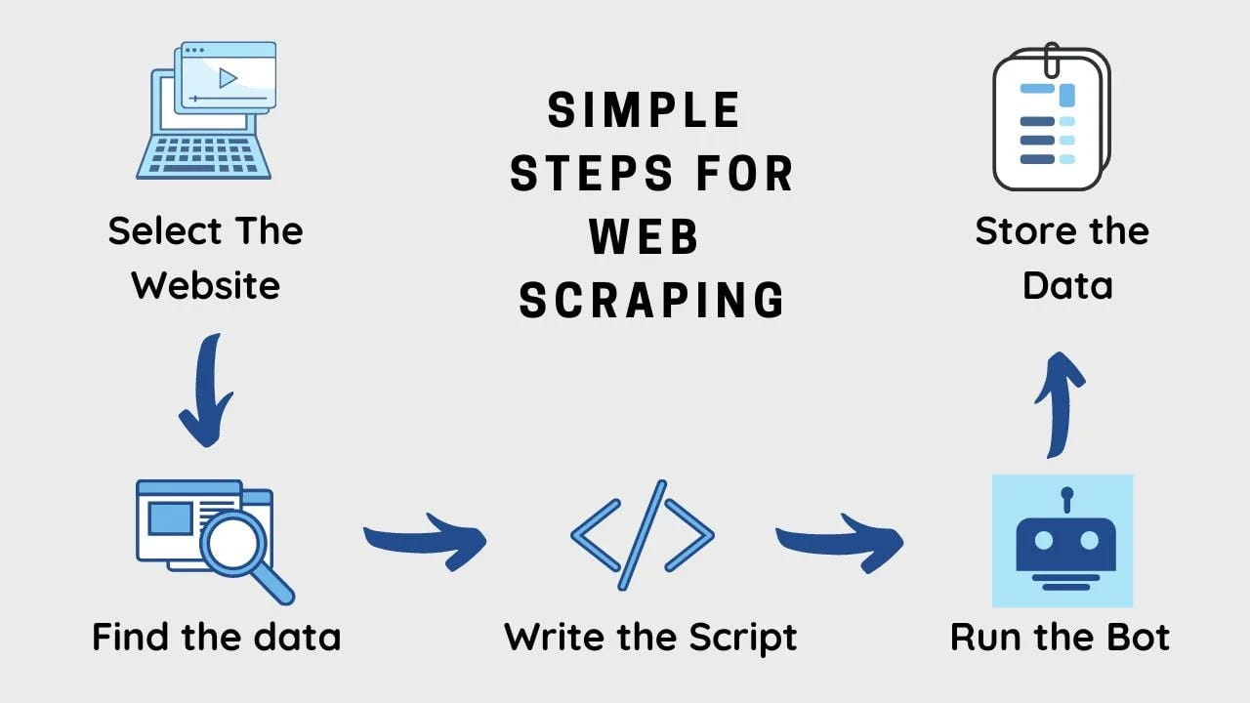
ARCHITECTURE

Slide 10


TARGET USERS
Travel Industry
Business Analysts
Market Researchers

Slide 11

MOTIVATION
Data Collection
Real-time Data updates
Research Purpose
Historical Data Collection
Efficient Price Comparison

Slide 12

HARDWARE REQUIREMENT
RAM: 6GB .
STORAGE : The amount of storage required depends on the volume of data being collected. Solid-state drives (SSDs) are preferred over HDD.
PROCESSOR :intel i3 or Higher versions preffered.

Slide 13
SOFTWARE REQUIRED
IDE :Google colab.
PACKAGES:
‘requests’ package : used to requesting the website.
Beautiful Soup is a library that is commonly used for web scraping purposes.
Pandas: Pandas is a popular Python library for data manipulation and analysis. It is often used in web scraping projects for storing and processing scraped data.
SqlLite3 : used to convert database.

Slide 14

Algorithm
Parsing Algorithms
TECHNIQUES:
HTTP Requests
User-Agent Rotation: User-agent rotation involves rotating the user-agent string sent in HTTP requests to mimic different web browsers or devices. This can help to avoid detection and prevent websites from blocking or restricting access based on user-agent.

Slide 15
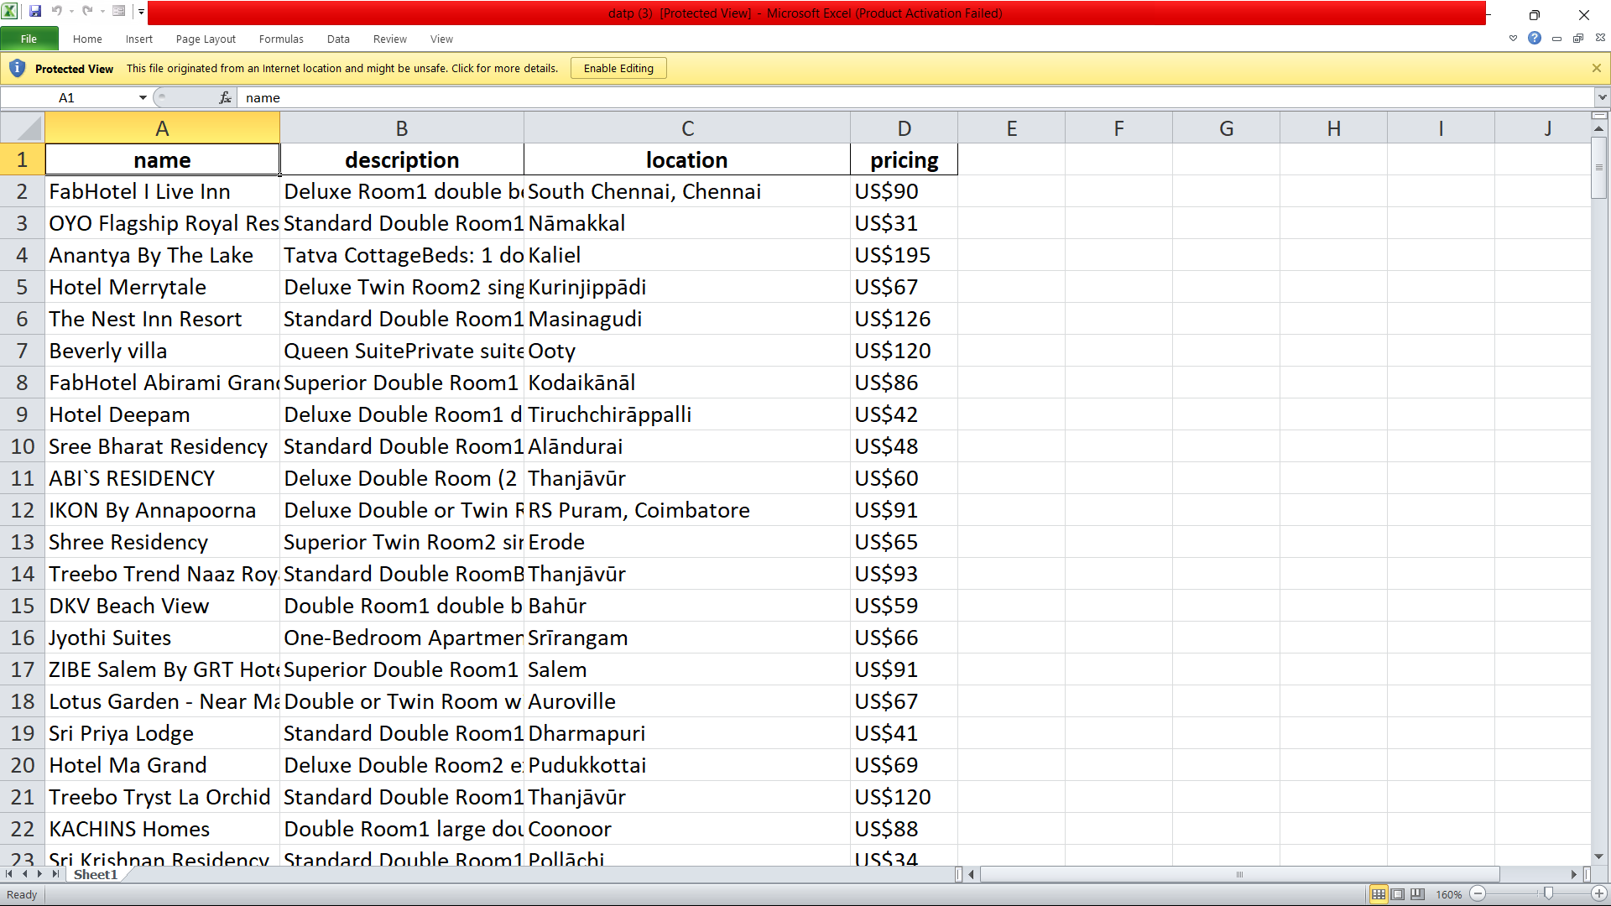
OUTPUT SCREENSHOTS Scrapped data from Tamilnadu

Slide 16
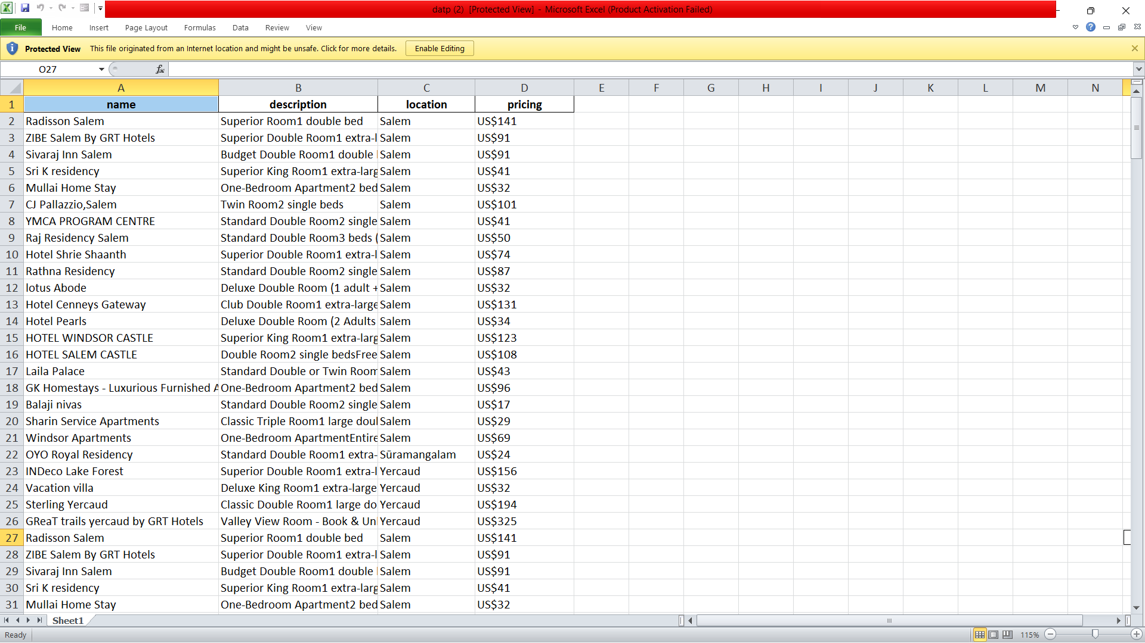
Scrapped data from Salem

Slide 17
Conclusion
Our mini project on web scraping from Booking.com has provided valuable insights into data extraction and analysis. Despite challenges, we successfully collected data on hotel listings, reviews, and pricing trends. This experience has equipped us with essential skills in web scraping and data manipulation. Moving forward, the knowledge gained will fuel future endeavors in data-driven decision-making and analysis.

Slide 18

Future Works
We scrapping the many websites using one code.
Utilize advanced statistical and machine learning techniques to derive deeper insights from the scraped data, such as predicting hotel occupancy rates or identifying seasonal pricing trends.
Develop a system for real-time monitoring of hotel availability, prices, and customer reviews on Booking.com, enabling timely adjustments to pricing strategies or marketing campaigns.

Slide 19
References
Review Booking.com's terms of service and their robots.txt file to understand any restrictions or guidelines they have regarding web scraping. This will help ensure compliance and avoid any legal issues.
Engage with online communities and forums like Stack Overflow, Reddit, or GitHub, where developers often share their experiences and provide advice on web scraping projects. You may find helpful tips and solutions to challenges encountered during scraping.
Search for YouTube tutorials, blogs, and articles that provide step-by-step guides on web scraping from Booking.com or similar websites. Many content creators share their techniques and insights for scraping data effectively.

Slide 20


